Slide 1
Smart Home Appliance
Guide: Asst. Prof. Gousia Thahniyath
Team Members: M Suma – ENG19CS0190
Neti Sahithi – ENG19CS0205
Parth Soni – ENG19CS0218

Slide 2
Content List
Introduction
Problem Statement
Objective
Literature Review
Module Wise breakdown
Functional Requirements
Design
Result Analysis
Conclusion

Slide 3
INTRODUCTION
Home automation is the control of any or all electrical devices in our home or office. There are many different types of home automation system available. These systems are typically designed and purchased for different purposes. In fact, one of the major problems in the area is that these different systems are neither interoperable nor interconnected. There are number of issues involve when designing a home automation system. It should also provide a user friendly interface on the host side, so that the devices can be easily setup, monitored and controlled.

Slide 4
Contd.,
There are many method by which we can implement home automation system. Some of the method are listed below:
Home Appliances Control Using A Remote Control
Home Appliances Control Using DTMF
Home Appliance Control Using Free Hand Gesture
Home Appliance Control Using Internet And Radio Connection
Wireless Browser Based Device Control Using Raspberry Pi

Slide 5
PROBLEM STATEMENT
Today we are living in 21st century. It is necessary to control the home from desire location. Home automation is the control of any electrically and electronics device in our home and office, whether we are there or away. There are hundreds of products available that allow us to control over the devices using remote control, DTMF, free hand gesture, internet and resource connection and so on.
This Home automation system provides the user with a web page control of various lights and appliances within their home with the help of raspberry pi. This system is designed to be low cost and expandable allowing a variety of devices to be controlled. Our Smart Home automation will be focused on how this can be achieved through the use of the raspberry pi.

Slide 6
OBJECTIVE
In this project we would like to share the procedure on how to build a home automation system with Raspberry Pi and Node Red.
We can use Raspberry Pi, a small single-board computer as the controller for this domestic web application.
The user can interact with the smartphone to manage the controller through a web application.
The basic aim of Home automation is to control or monitor signals from different appliances, or basic services. A smart phone or web browser can be used to control or monitor the home automation system.
As for what this project is concerned, one can automate their home within their home network only

Slide 7
Literature Review

Slide 8
Hand Gesture based Automation
Author Name | Year of Publication | Description | Limitations
Manoj Harsule 2. Prashant Ingole | 2013 | This is a type of home appliance control system where the person must be present in sight to the appliance that is needed to be controlled and a predefined gesture must be used to turn on the device and another gesture must be used by us to turn off the device. The performance of the proposed system is done with a hardware embedded in that particular device. | This process is only suitable in light places and cannot be used in dark places or in the noisy background. It's expensive.

Slide 9
DTMF based Automation
Author Name | Year of Publication | Description | Limitations
Md. Mamunoor Islam Mehdi Hasan Chowdhury | 2014 | In this method, the control of home appliances can be done even though when we are elsewhere just by using the DTMF tone generated when the user pushes mobile phone keypad buttons or when connected to a remote mobile. | There is no security. Anyone can control their appliance by calling the mobile connected to the module. There is a limitation for connecting the appliances we want to connect as a mobile can generate only 16 tones.

Slide 10
Remote Control based Automation
Author Name | Year of Publication | Description | Limitations
Chintha Rajendra Benny pears O. Vijayalaxmi Varsha Devi B. Sanjai Prasad. | 2017 | The lights, fans can be automatically turned on/off with the help of a remote where there will be a sensor instead of going near to a switch board and putting on/off the switch. Companies like Legrand and Gold Medal already started these kinds of control system and they are at present available in the market | While controlling the appliance, each time we have to point out the remote towards the appliance to control them. The appliances cannot be controlled from any other room as the IR wave cannot travel through the door or wall.

Slide 11
Internet and Radio based Automation
Author Name | Year of publication | Description | Limitations
Ravi Kishore Kodali Sreeramya Soratkal Lakshmi Boppana. | 2016 | In this system, the control of home appliances can be done from a remote are with an option from a local server, using the Internet and radio connection. This system is accomplished by personal computers, interface cards, radio transmitters and receivers, microprocessors, ac phase control circuits, along with window-type software and microprocessor control software. | It is limited to a specific distance. It can be used only to that specific area or part to cover. The number of devices that need to be connected is also limited.

Slide 12
Module Wise break down
Setting up Raspberry Pi
Installing and Running Node-Red
Making Node-flows
Assembling Components

Slide 13
Module 1: Setting up Raspberry Pi
Version used: Raspberry pi 3B+
New Micro SD card, formatted
Install Raspberry pi Imager
Open advance settings, and enable SSH
Give Wi-Fi user_id and password directly in the advance settings.
Installation target destination should be SD card.
Insert the micro SD card in the pi and boot it.

Slide 14
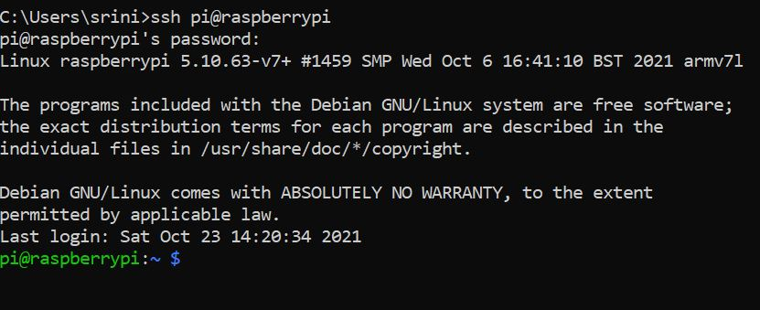
Outcome Step 1
It was set up successfully.

Slide 15
Module 2: Installing and Running Node-RED
Install “Buster” software package from raspberry pi’s desktop interface : Select Menu->Softwears->buster->install
Open pi terminal and run the below command:
bash <(curl -sL https://raw.githubusercontent.com/node-red/linux-installers/master/deb/update-nodejs-and-nodered)
Install some extra nodes
cd ~/.node-red
npm install node-red-contrib-gpio
npm install node-red-contrib-ui
Once its installed, run the below commands:
Node-red-start
It will give some IP address, copy it.
Paste that address in your browser
Node-RED ready to use

Slide 16
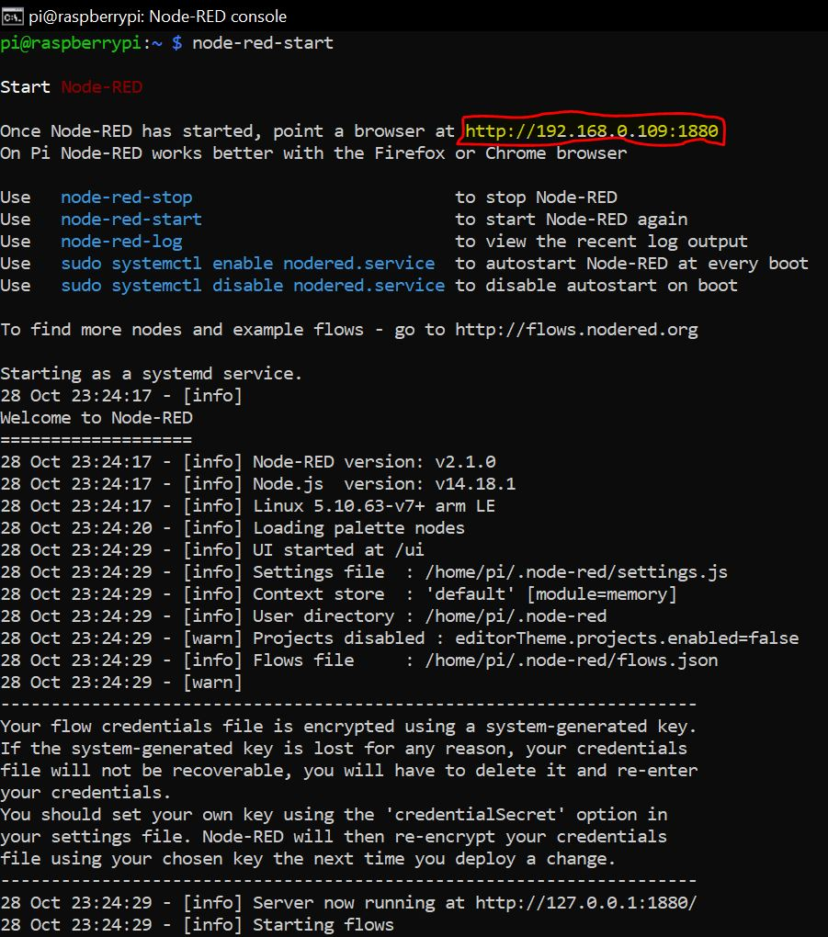
Outcome Step 2
Node-RED is up and running successfully.

Slide 17
Module 3: Creating Node-flows
Run the Node-RED interface in browser.
Use the nodes panel to get appropriate nodes for the project
Then configure each node accordingly
Post this, give connections to each nodes as configured.
Deploy the node-flow

Slide 18
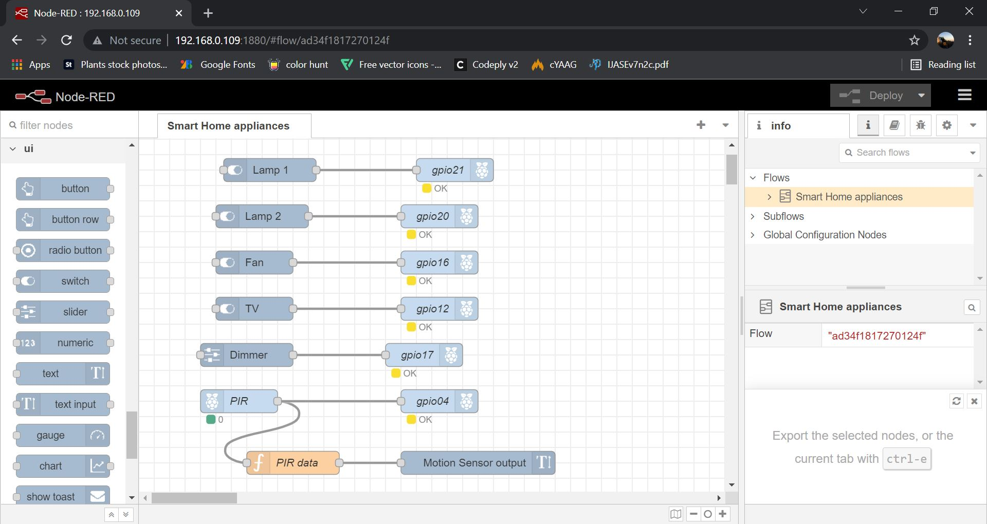
Outcome Step 3
Node flows created and deployed successfully

Slide 19
Module 4: Assembling the components
Once the node-flow is set, make a note of the configuration done.
Now connect the hardware components to raspberry pi according to the node-flow diagram.
Give power supply to the pi and run the UI.

Slide 20
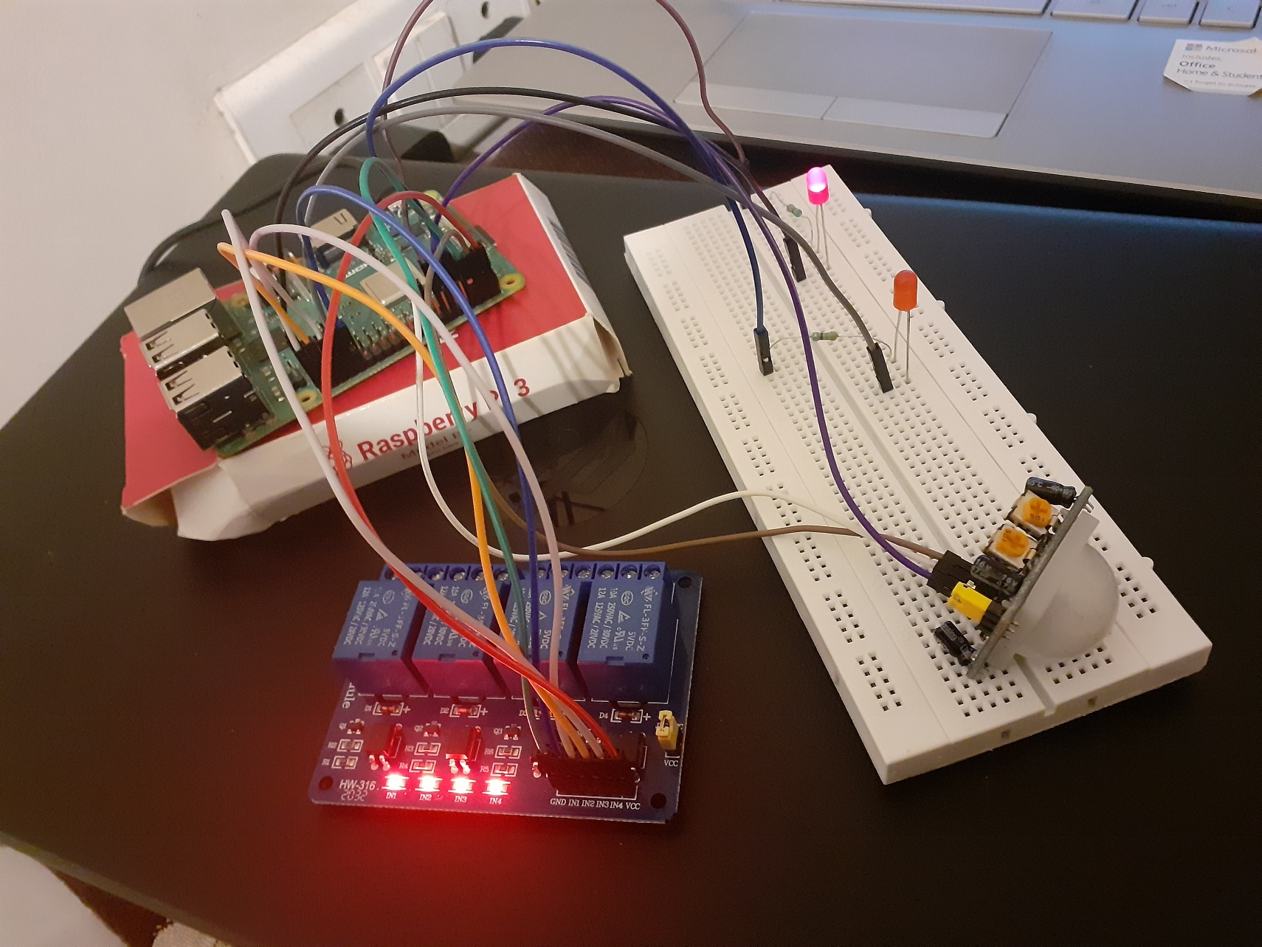
Outcome step 4
The final hardware set up was successful.

Slide 21
FUNCTIONAL REQUIREMENTS
HARDWARE REQUIREMENTS
SOFTWEAR REQUIREMENTS
Raspberry PI 3
Led's(multi coloured for better visuals)
5V , 4 channel relay board
PIR motion sensor
Resistor 330 ohm
Jumper cables
SD card formatter
Raspbian OS
Buster OS
VNC Viewer
Advance IP scanner
Node Red

Slide 22
Design
System architecture, node-flows, UI

Slide 23
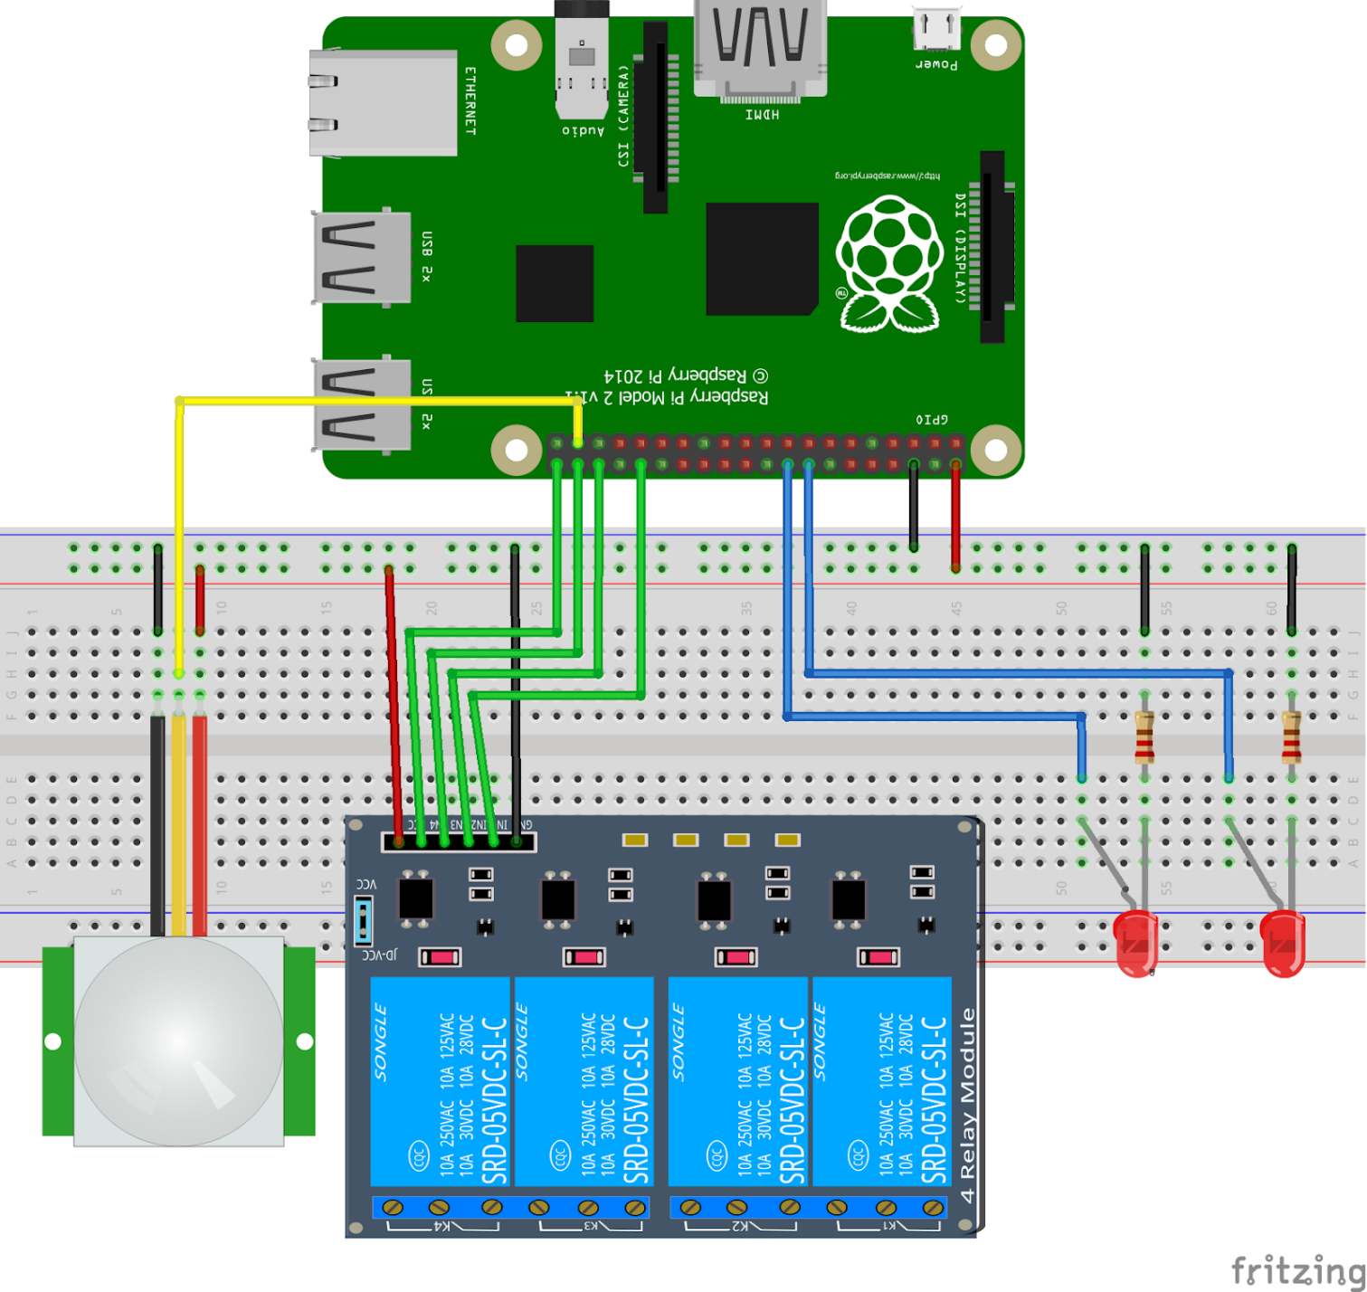
Architecture
The raspberry pi connects the led , the motion sensor and the relay board through jumper cable wires. The relay board is used as a switch and also as a regulator to control the intensity of the LED's which represent bulbs. The motion sensor is used to detect any movement , if any movement is detected , it would display a predefined message on the webpage.

Slide 24
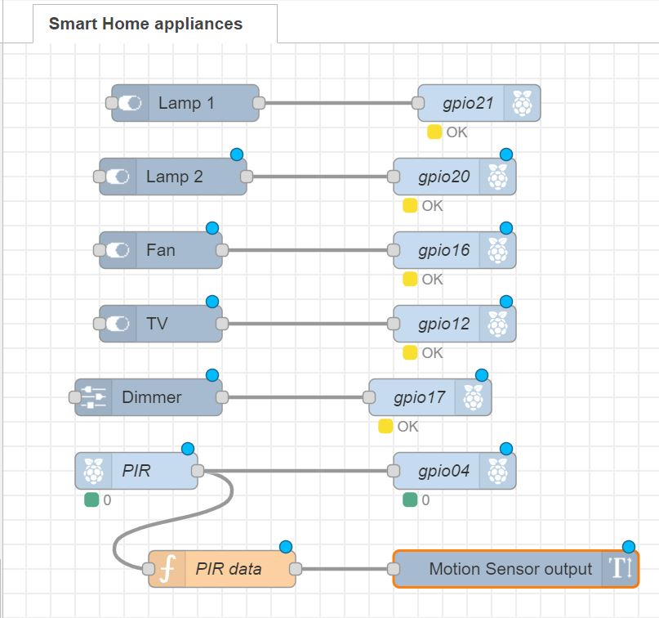
Node-flows
Switch Nodes -> Appliance
Raspberry pi nodes -> In/O pins
Function Node -> Sensor Algorithm
Connectors-> connecting pins and appliance’s switch

Slide 25
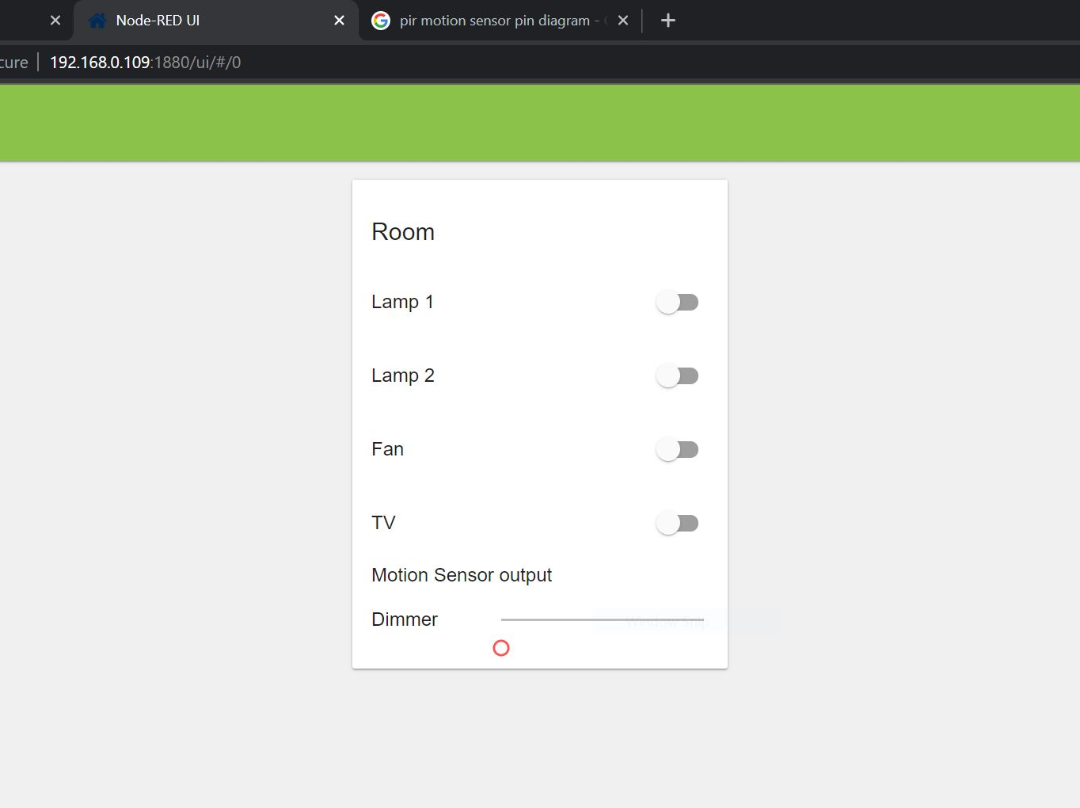
UI The output of the previous node flow’s configuration.

Slide 26
Result Analysis
Testing

Slide 27
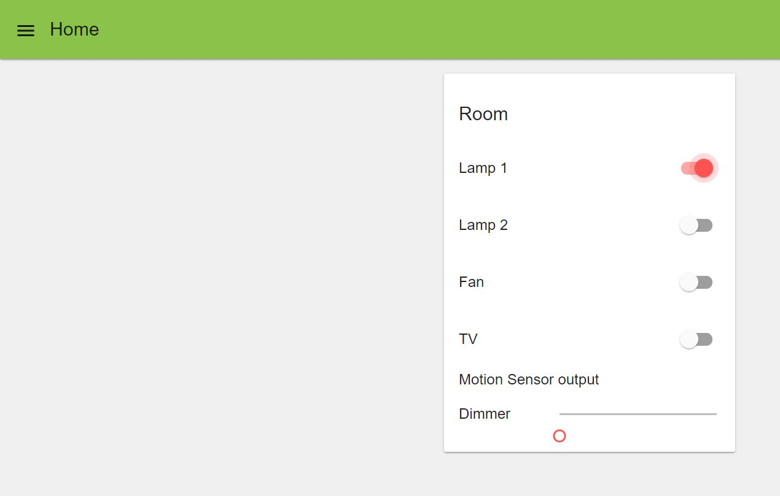
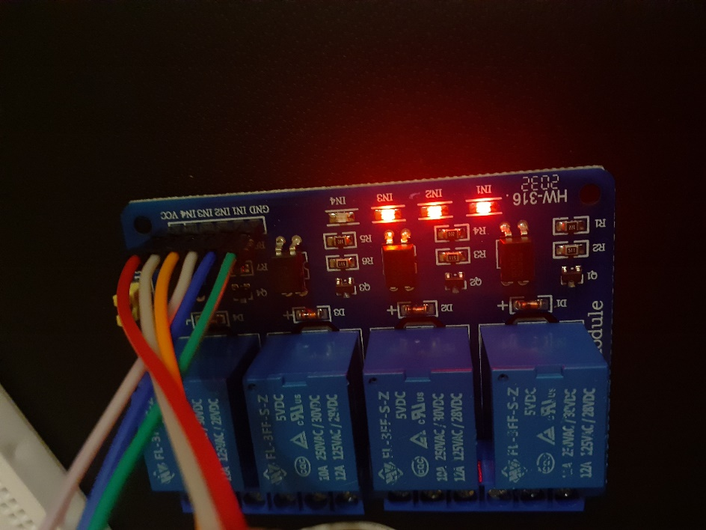
Testing Relay Board.
Analysis:
Relay board acts an indicator, where each device that will be in automation system represents one indicator on relay board.
When we on a device from UI, the associated indicator on relay board will be off.

Slide 28
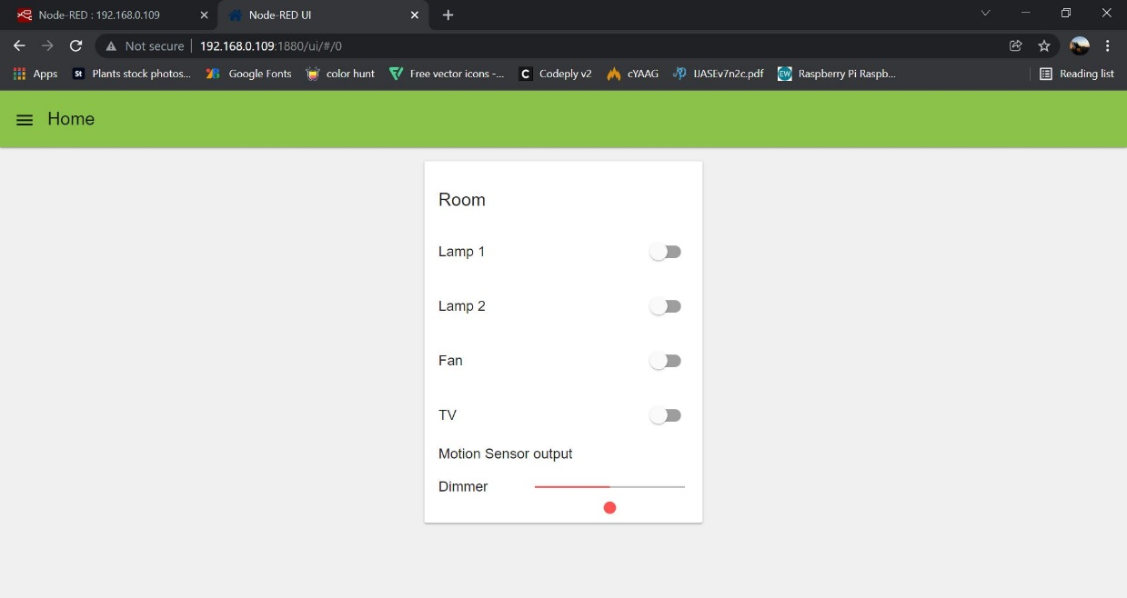
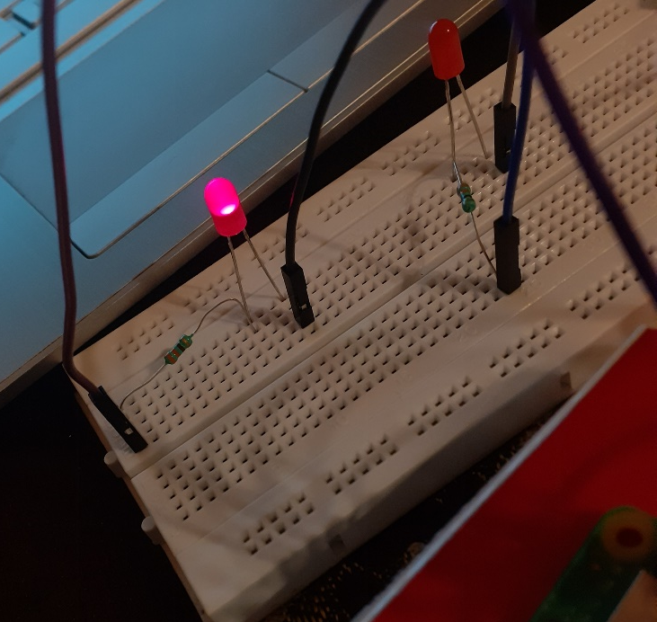
Testing Dimmer
Analysis:
Works perfectly, as designed.

Slide 29
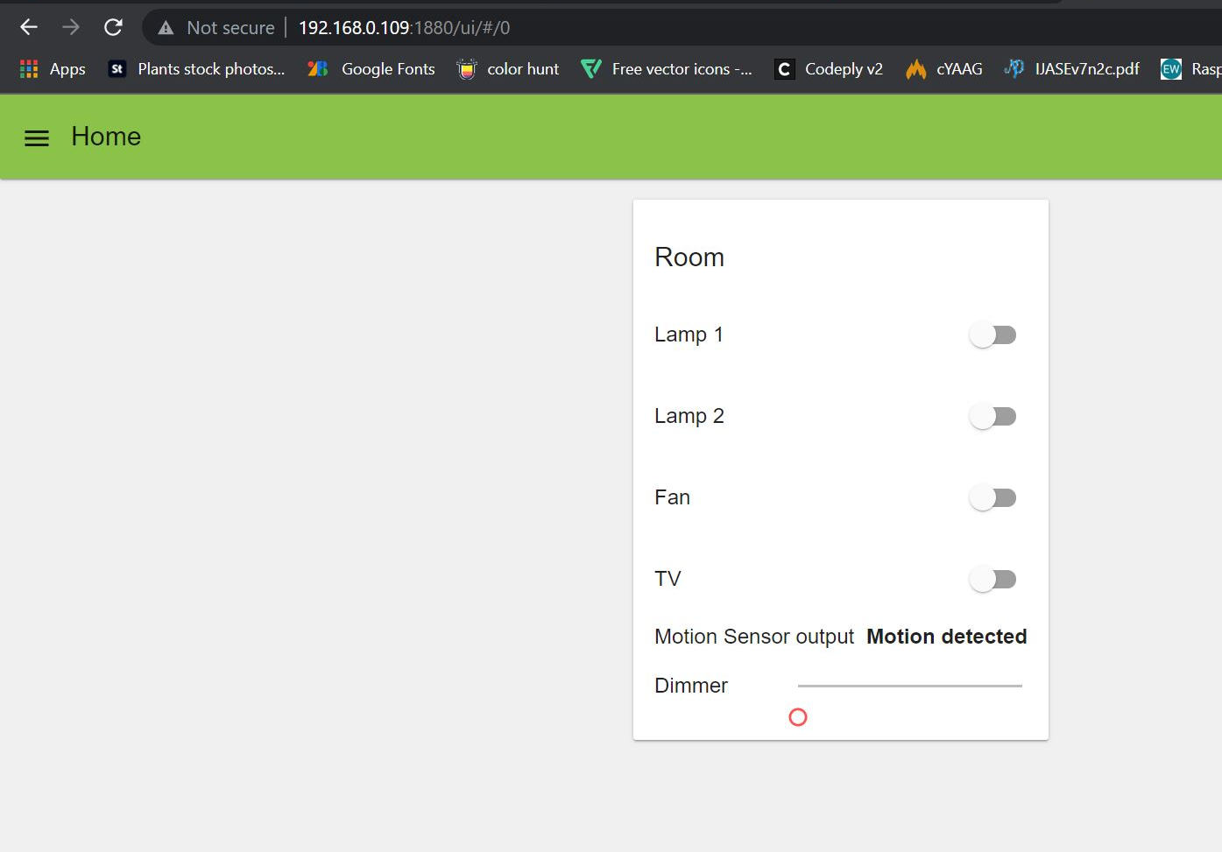
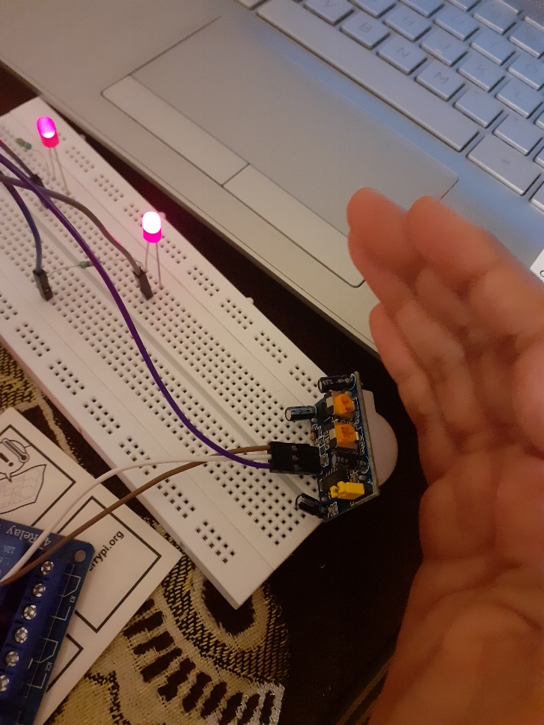
Testing PIR motion sensor
Analysis:
When there is a movement, it displays “Motion Detected” and the associated LED blinks.
When there is no motion it doesn’t display anything.

Slide 30
Conclusion
We have obtained the prototype for smart home automation.
Now one can control their home devices by web browser in smart phone, tablet or computer.
Cost-efficient
Future Scope:
Can integrate a voice assistant like alexa, google etc
It is expandable and adaptable

Slide 31
THANK YOU!

